Slide 1
Professional Activities & IEEE Region 8 Young Professionals
Manuel Ballesteros Carballo
IEEE R8 YP Member & SCADA Engineer
m.ballesteros.carballo@ieee.org
a.k.a. – Professional Development
Let's explore the IEEE YP world together

Slide 2


Professional Activities
What sorcery is this?
From the first degree up to 15 years later
Develop your Soft Skills

Slide 3

Manager vs Leader

Slide 4

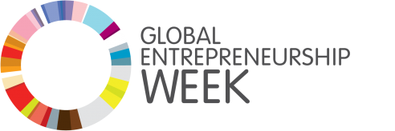
Distinguished Lecturers to companies
Power and Energy sector (initially)
Pilot in Germany and Italy
Company / University
Tailored industry YP

Slide 5

Entrepeneurship

Slide 6

- Technical entrepreneurship
R8 Entrepreneurship Initiative
Together with R8 PEA, collaboration with AfI & SAC
110 ambassadors from 35 sections → selected 50+
Pitching competitions during GEW (Nov. 18-24)
Finals at SYP 2020

Slide 7
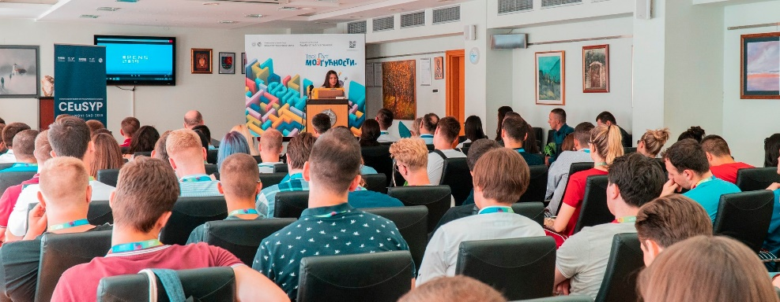
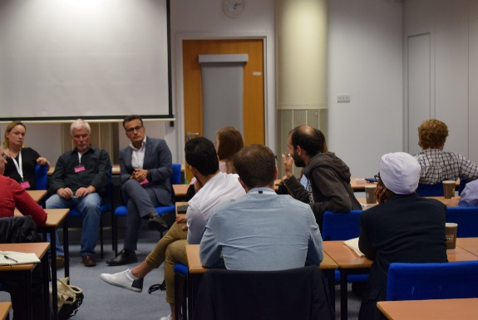
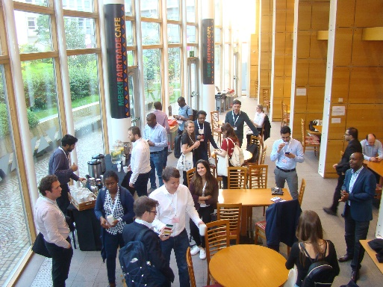
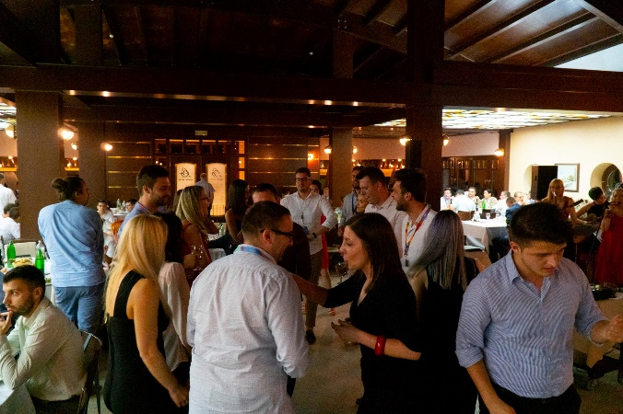
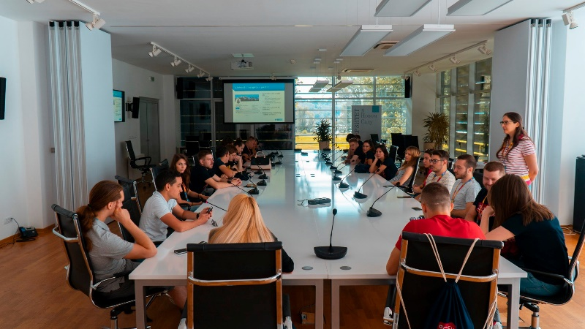
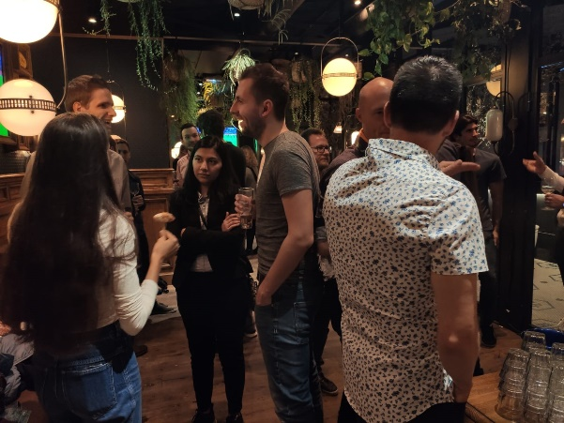
Talspreneur & YPitch

Slide 8

Creativity

Slide 9

Creativity
Awards IEEE - Loyalty and recognition
https://www.ieee.org/about/awards/index.html
Contribute to your personal development

Slide 10

Networking

Slide 11

ma-yp@ieeer8.org

Slide 12
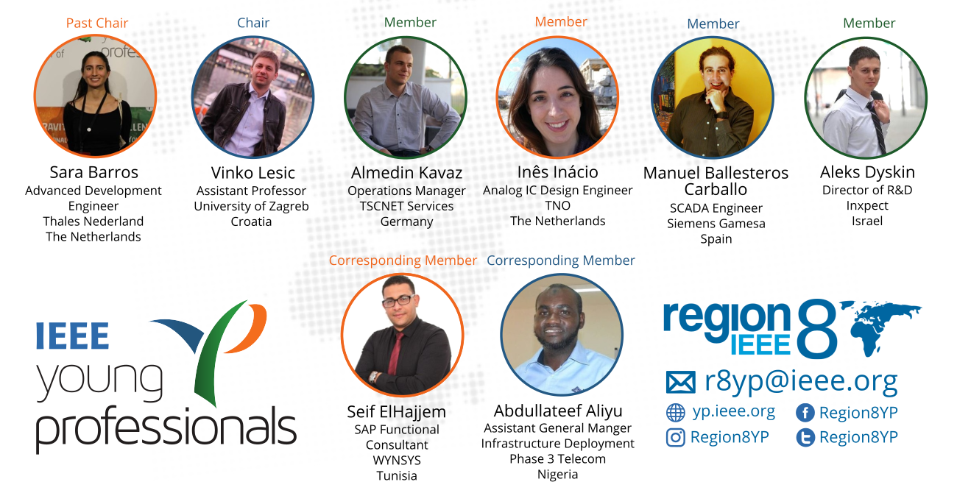
Region 8 Young Professionals Subcommittee
2019

Slide 13
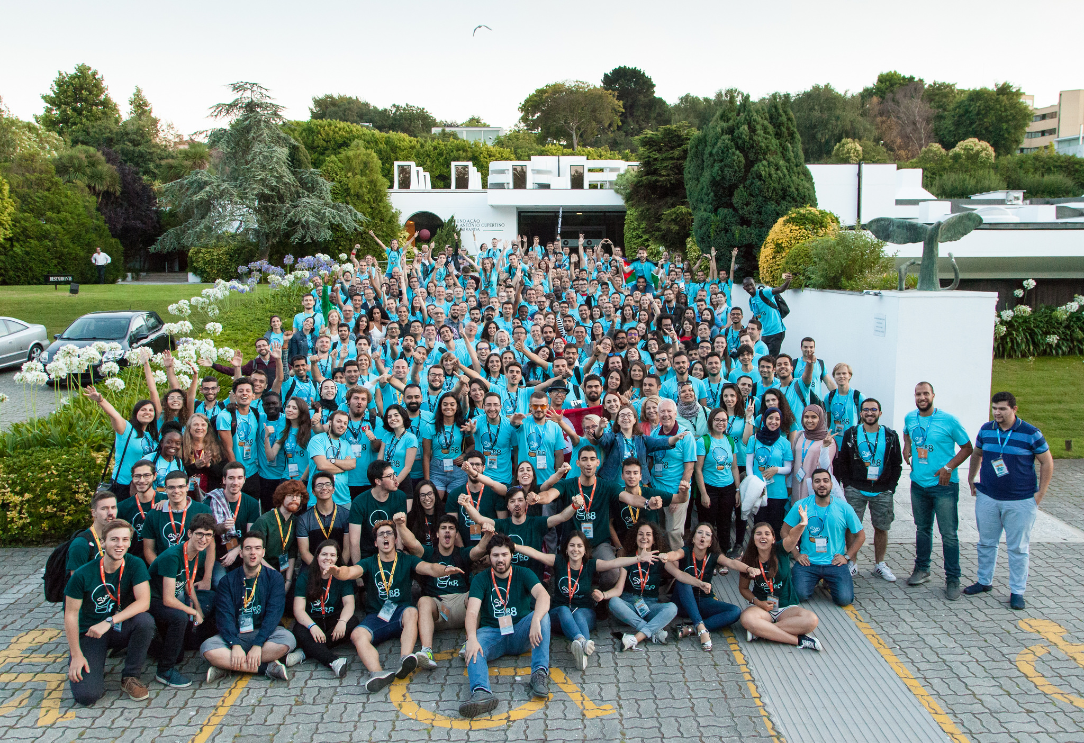

Slide 14
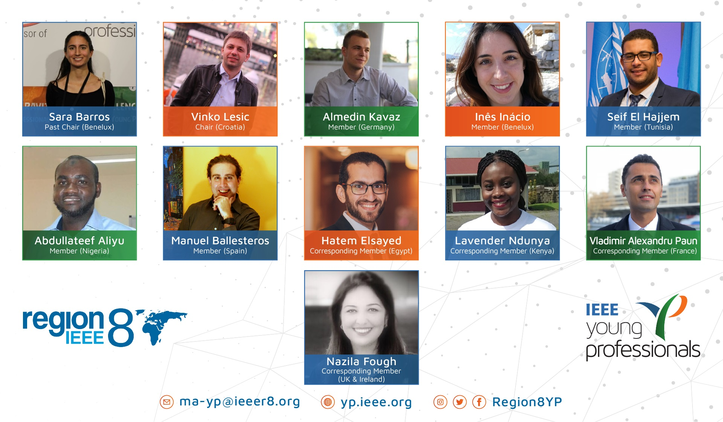
Region 8 Young Professionals Subcommittee
2020

Slide 15

Motivation

Slide 16



Young employees
GRADUATION
Academy, industry, entrepreneurship
Settling down, learning technology, tools, relations – what then?
New knowledge, technologies and products are combination of:
Heritage (previous knowledge)
Fresh ideas (approaches, technologies)
New opportunities (needs, market, funding sources)
Multidisciplinarity (hot topic)
Boosted by bringing inputs from outside the company
First step, networking and contacts

Slide 17
Hola Manuel
Seguimos con el proceso abierto, esperamos que entre tu red de contactos puedas ayudarme.
El trabajo consistirá principalmente en desarrollar pruebas automáticas del interfaz de usuario web. Puntualmente, podría diseñar y ejecutar pruebas manualmente.
Por tanto, además de que el candidato debe conocer el mundo de las pruebas de SW, en esta caso es importante los siguientes conocimientos:
Programamming:
Server/Client:
C#
Technology WPF
Web:
Unit Test development (c#) (e.g. NUnit, XUnit)
UI Test development (javascript/typescript) (e.g. Jasmine, Mocha)
End to End testing (angularJs, angular) (e.g. Protractor)
Automatization
Continuous Integration (e.g. Jenkins, TFS, …)
Version Deployment(e.g. VMWare, Docker,…)
Ubicación Madrid
What I know asking it
28.000€
Work by objectives in a consolidated project
No overtime
Young Engineers
Job Offer 1

Slide 18
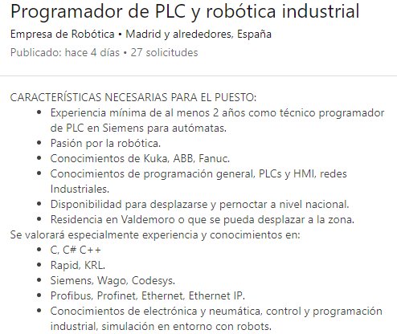

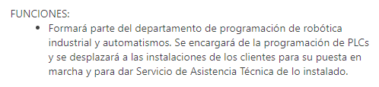
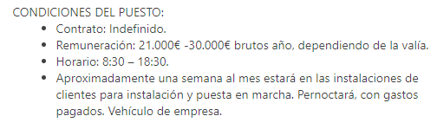
Job Offer 2

Slide 19

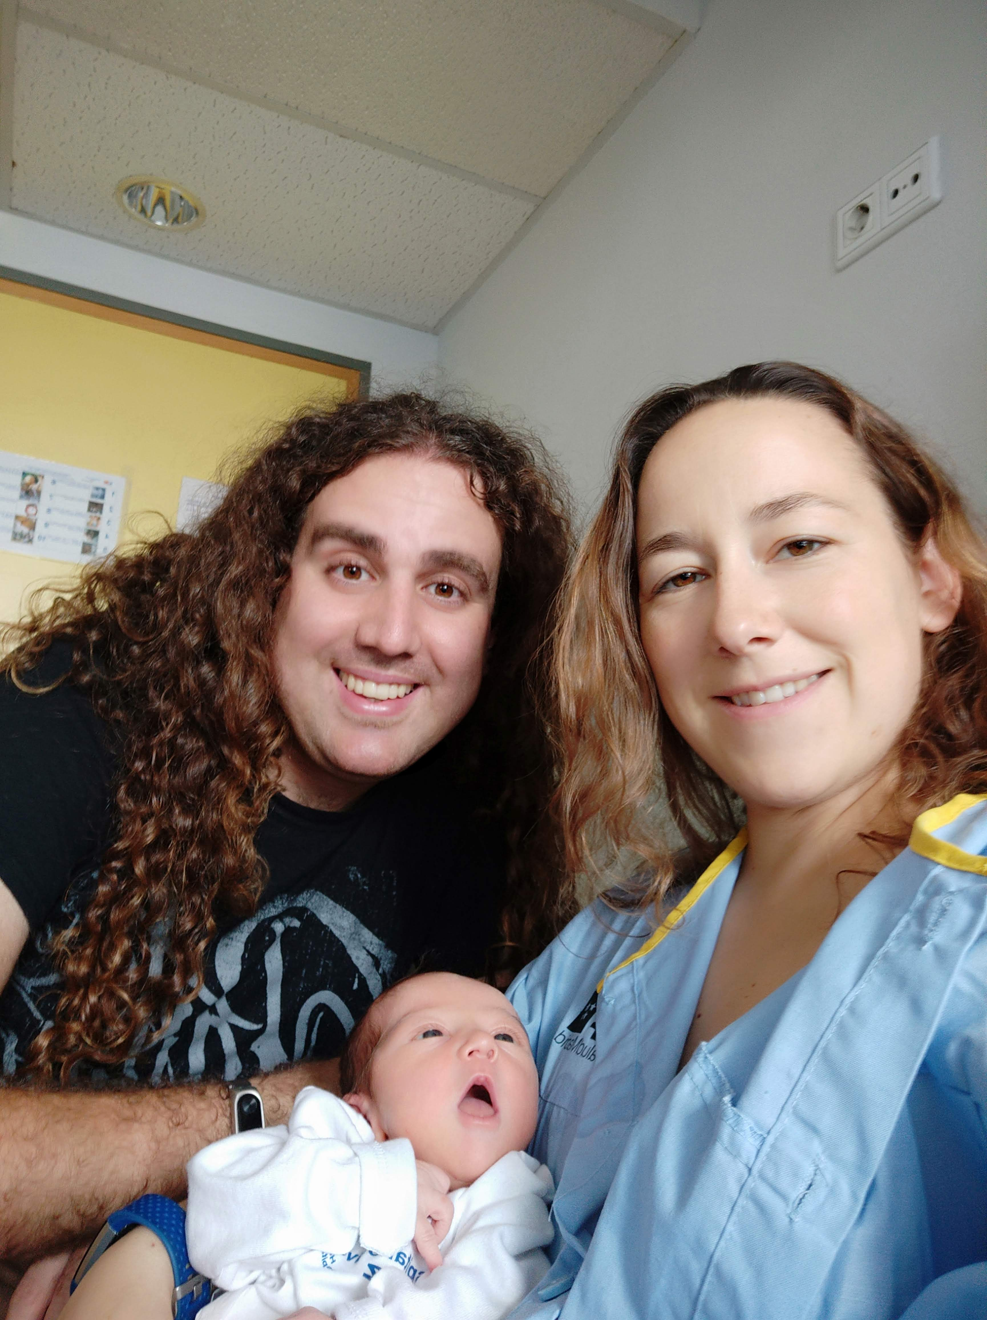

Slide 20
Professional Activities & IEEE Region 8 Young Professionals
Manuel Ballesteros Carballo
IEEE R8 YP Member & SCADA Engineer
m.ballesteros.carballo@ieee.org
a.k.a. – Professional Development
Let's explore the IEEE YP world together

